Slide 1
HDFS
Sathia kumar

Slide 2
hadoop nutch project ,
Yahoo
Doug cutting
Google published 2 white papers
GFS - hadoop distributed file system (hdfs)
MapReduce - Distributed computing
Hadoop distributions
Cloudera
Hortonworks
MapR

Slide 3
Basics – optional
Program
sequence of instructions written to perform a specified task with a computer
or a piece of code
Process
an instance of a computer program that is being executed.
or a execution of a program
Daemon Process
process which runs in background and has no controlling terminal.
JVM – Java Virtual Machine
program which executes certain programs, namely those containing Java bytecode instructions

Slide 4
Basics – optional
Client-server Concept
Client sends requests to one or more servers which in turn accepts, processes them and return the requested information to the client.
A server might run a software which listens on particular ip and port number for requests
Examples:
Server - web server
Client – web browser

Slide 5
Introduction
A distributed File System - STORAGE
A File System on multiple machines which sits on native filesystem
ext4,ext3
Hardware Failure
Due to usage of Commodity machines, failure is a common phenomenon
Designed for failure
Large Data Sets
Small Files Problem Due to NameNode
Simple Coherency Model
Write Once , Read Many Times
Streaming Data Access
High Throughput instead of low latency access

Slide 6
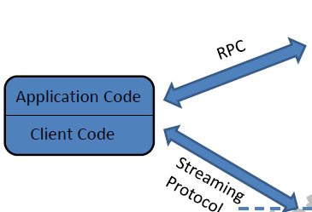
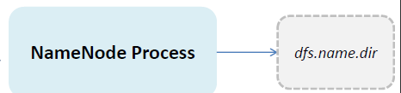
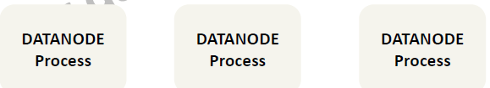
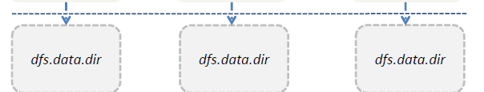
Continued…

Slide 7
Daemons in Hadoop Core
NameNode
DataNode
Secondary NameNode*
JobTracker*
TaskTracker*
* - will be seen later
HDFS
MR

Slide 8
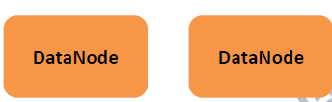




Block Concept
TestFile1.txt -> 1GB
Block Size -> 64 MB
No of Blocks = 1GB / 64MB = 16 blocks
Blocks are B1,B2,…..B16
Files are splitted into number of chunks(Blocks) of pre-defined size

Slide 9

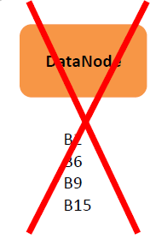
Block Concept
TestFile1.txt -> 1GB
Block Size -> 64 MB
No of Blocks = 1GB / 64MB = 16 blocks
Blocks are B1,B2,…..B16
Files are splitted into number of chunks(Blocks) of pre-defined size

Slide 10
Fault Tolerant in HDFS
TestFile1.txt -> 1GB
Block Size -> 64 MB
No of Blocks = 1GB / 64MB = 16 blocks
Blocks are B1,B2,…..B16
HDFS provides fault tolerant by replication of each block by 3

Slide 11
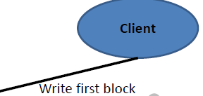
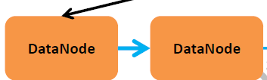

Data Pipelining
TestFile1.txt -> 1GB
Block Size -> 64 MB
No of Blocks = 1GB / 64MB = 16 blocks
Blocks are B1,B2,…..B16

Slide 12
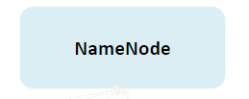
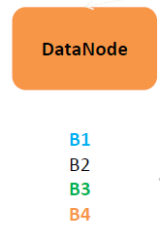

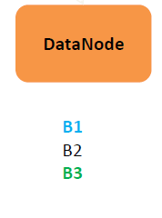


Role of NameNode
Stores the metadata (info about the files and blocks)
-File Management(contains the metadata)
-Block and Replica Management
-Health of datanodes through block reports

Slide 13
Execution Modes &Installation
Modes
Single Stand Alone
All Process runs in a single jvm
Does not use HDFS
Pseudo Distributed Mode - for our training
All daemon process runs in separate jvm in a single local machine
Used for development and testing
Uses HDFS to store data
Distributed Mode
A cluster of nodes more than 1
Each Process may run in different nodes
Please follow instructor and doc provided

Slide 14
Installation
Download and install hadoop 1.2.7
tar -zxvf backup.tar.gz
sh jdk-6u38-linux-x86.bin
(refer the doc. Shared )

Slide 15
Ports used by Hadoop Daemons
Daemon RPC WEB
NameNode 8020 (50000*) 50070
SecondaryNameNode 50090
JobTracker 8021(50001*) 50030
TaskTracker 50020 50060
DataNode 50010 50075

Slide 16
Post installation
jps
JPS - JVM profiling status tool
Web UI
NameNode - http://localhost:50070
JobTracker – http://localhost:50030

Slide 17
Accessing HDFS
Command line
Usage: hadoop dfs <command>
JAVA API
webHDFS

Slide 18
HDFS commands
hadoop dfs -copyFromLocal <srcLOCALfile> <destHDFSfile>
hadoop dfs -ls /
hadoop dfs -cat /<destHDFSfile>
hadoop dfs -copyToLocal <srcHDFSfile> <destLOCALfile>
hadoop dfs -mkdir /test
hadoop dfs –rmr /test
Please follow the document given

Slide 19
JAVA API
Most Packages Used
org.apache.hadoop.conf.Configuration
org.apache.hadoop.fs.BlockLocation
org.apache.hadoop.fs.FSDataInputStream
org.apache.hadoop.fs.FSDataOutputStream
org.apache.hadoop.fs.FileStatus
org.apache.hadoop.fs.FileSystem
org.apache.hadoop.fs.Path
org.apache.hadoop.hdfs.DistributedFileSystem
org.apache.hadoop.hdfs.protocol.DatanodeInfo
Please see and execute the example code provided

Slide 20
File System API methods
append()
copyFromLocalFile()
create()
delete()
mkdirs()
open()

Slide 21
Secondary NameNode*
A helper node for NameNode
performs memory-intensive administrative functions for the
NameNode
Have a checkpoint for the file system (HDFS)
Not a Backup Node

Slide 22
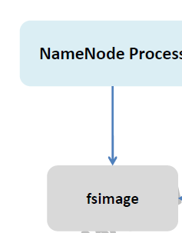

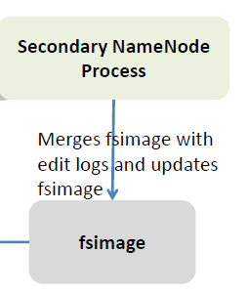

Role of Secondary NameNode

Slide 23
Hadoop Version 2 & 3

Slide 24
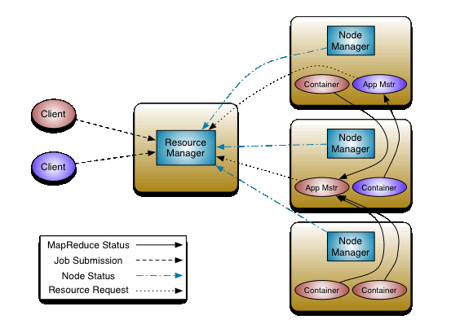

Slide 25
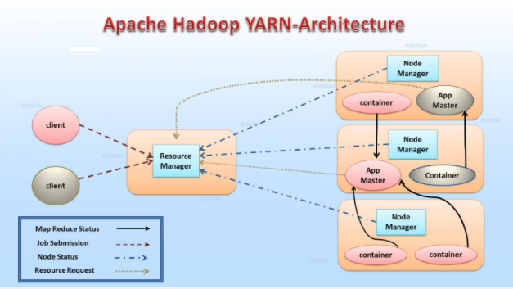
Hadoop 2 – Yarn Architecture

Slide 26
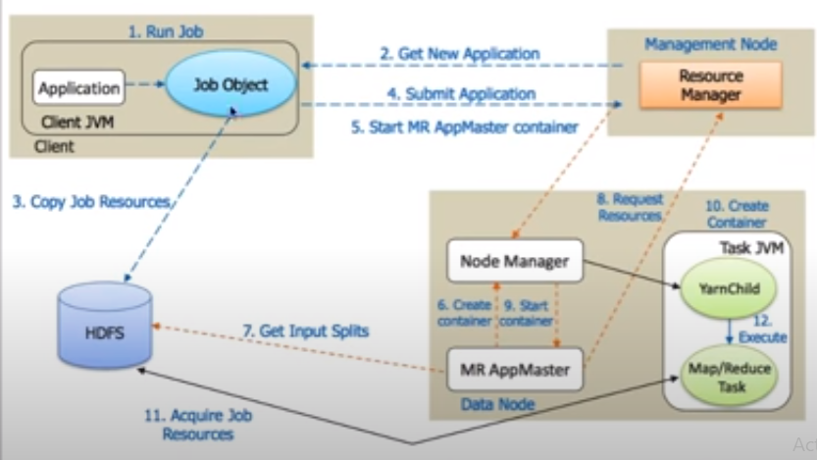
s
Notes:
m_
Execution flow
Client submits an application your resource manager gets the application request . It will first launch the appmaster by talking to a node manager
Your app master will then talk to the name node to figure out where are the blocks present that need to be processed and then it will
Get the resources from the resource manager to run the task that can process those particular blocks and then it will launch those
Tasks,these tasks will read the data directly from the hdfs and process it

Slide 27
Resource Manger
It is the master daemon of Yarn. RM manages the global assignments of resources (CPU and memory) among all the applications. It arbitrates system resources between competing applications. follow Resource Manager guide to learn Yarn Resource manager in great detail. Resource Manager has two Main components
Scheduler
Application manager

Slide 28
a) Scheduler
The scheduler is responsible for allocating the resources to the running application. The scheduler is pure scheduler it means that it performs no monitoring no tracking for the application and even doesn’t guarantees about restarting failed tasks either due to application failure or hardware failures.
b) Application Manager
It manages running Application Masters in the cluster, i.e., it is responsible for starting application masters and for monitoring and restarting them on different nodes in case of failures.

Slide 29
3.2. Node Manager (NM)
It is the slave daemon of Yarn. NM is responsible for containers monitoring their resource usage and reporting the same to the ResourceManager. Manage the user process on that machine. Yarn NodeManager also tracks the health of the node on which it is running. The design also allows plugging long-running auxiliary services to the NM; these are application-specific services, specified as part of the configurations and loaded by the NM during startup. A shuffle is a typical auxiliary service by the NMs for MapReduce applications on YARN
3.3. Application Master (AM)
One application master runs per application. It negotiates resources from the resource manager and works with the node manager. It Manages the application life cycle. The AM acquires containers from the RM’s Scheduler before contacting the corresponding NMs to start the application’s individual tasks.
.

Slide 30
